Slide 1



Clarity In Financial Flows
Presented By:
SHAMBHAVI CV (1SJ23CS151)
SUJAY D (1VE23CA043)
SNEHA SHREE M (1SJ23CS160)
DiSHA NB(1VE23CA016)
Team Name :Fund flow.ai

Slide 2

Problem Statement
Based on the identified problem statement, in this project we are addressing the challenge of financial opacity in institutions, where the movement of funds from budgets to departments, projects, and vendors is not easily visible or understandable.
In this proposed system, we aim to design a transparent financial flow framework that simplifies complex budget divisions and presents them in a way that can be clearly understood by citizens, students, parents, and other stakeholders.
In this solution model, we transform raw, scattered financial data into an accessible and interactive format, bringing clarity, accountability, and confidence in how institutions manage their resources.
In this project, we emphasize user-centric visualization techniques that make financial information easy to follow, regardless of a person’s technical background.
our goal is to bridge the gap between financial complexity and public understanding, ultimately creating an ecosystem of openness, responsibility, and trust.

Slide 3

Introduction
The ultimate goal is to make institutional finances transparent, reliable, and easy for everyone to grasp.
Stakeholders like citizens, students, and parents often have no clear way to see where funds go.
Many institutions struggle to show how their funds are allocated, leaving stakeholders uncertain about where the money goes.
Lack of clarity in budget distribution creates confusion and reduces trust among citizens, students, parents, and staff.
Our solution changes that by clearly showing how money moves across departments, projects, and vendors.

Slide 4
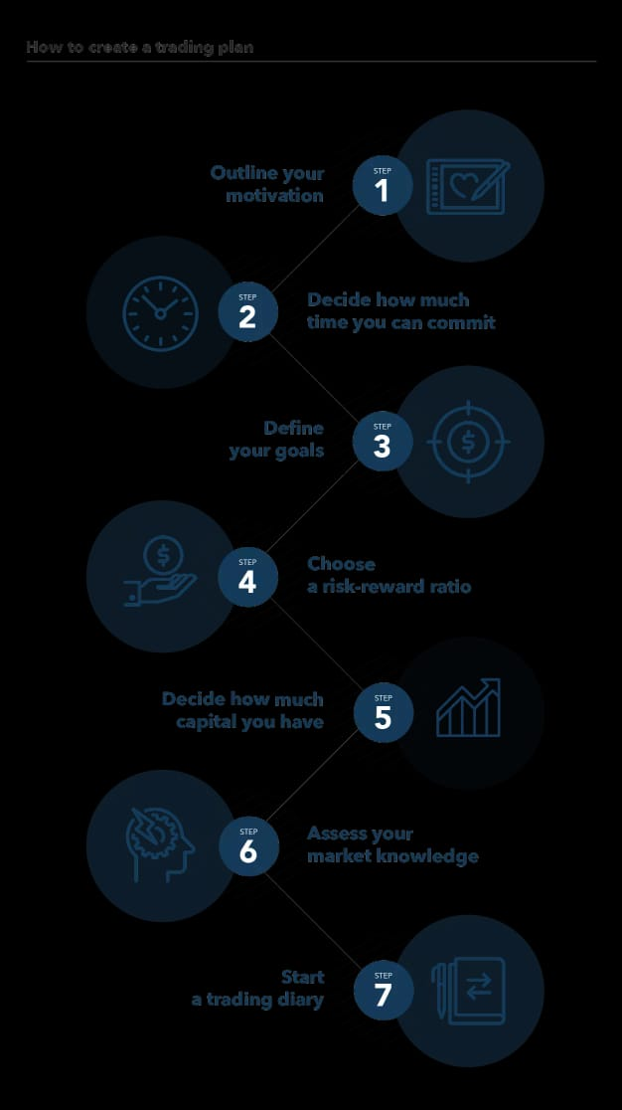
Objectives
To bridge the communication gap between institutions and the public by presenting fund flow data in a transparent way, fostering openness and inclusivity in financial processes..
To reduce the chances of misuse or mismanagement of funds by implementing a transparent system that ensures every expense is tracked and justified.
To enable real-time monitoring and tracking of fund utilization, making it easier to detect irregularities and take corrective measures promptly
To enhance accountability and trust by making financial flows open, traceable, and verifiable, reducing doubts or confusion around institutional spending.
To simplify complex financial data into clear and understandable formats, so that even non-technical stakeholders like parents, students, and citizens can easily grasp how money is being spent.
To visualize the budget distribution across departments, projects, and vendors in an intuitive and interactive manner, helping stakeholders see exactly where and how resources are directed.

Slide 5
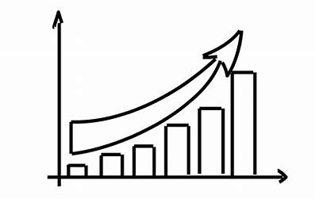
System Features
Architecture Diagram
Real-Time Fund Tracking – Monitor fund flow from allocation to end usage.
Interactive Dashboards – Easy-to-understand visuals (charts, graphs, flow
diagrams).
Multi-Level Breakdown – Budget split into departments, projects, and vendors.
Role-Based Access – Different views for citizens, students, parents, and officials.
Data Authenticity – Secure, traceable, and tamper-proof records (audit
logs/blockchain).
Mobile & Web Access – Anytime, anywhere access for all stakeholders.
Alerts & Notifications – Automatic updates on fund release and utilization.

Slide 6

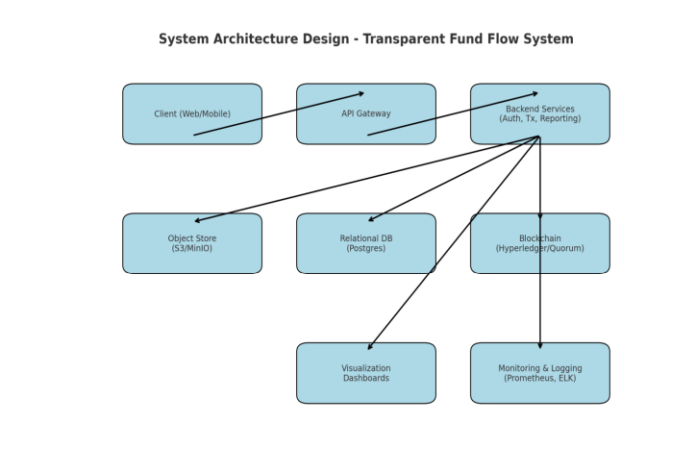
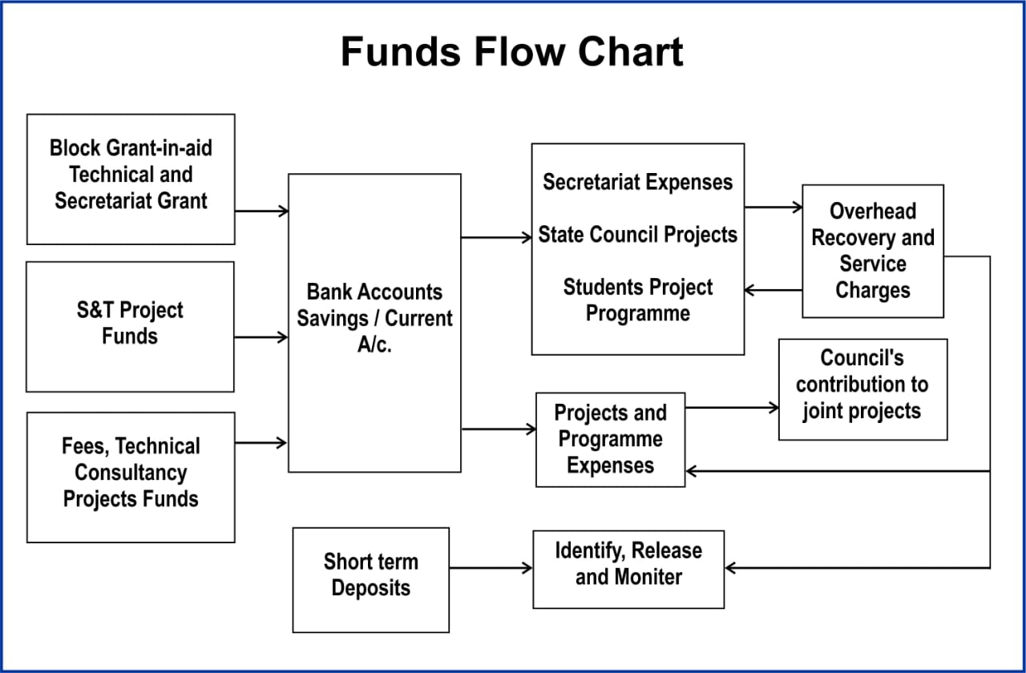
Architecture Diagram

Slide 7
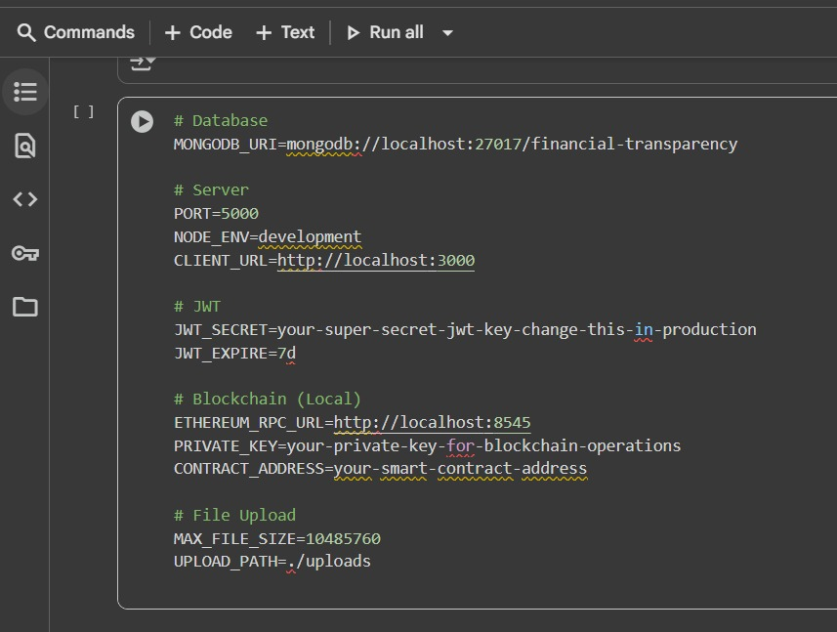
Implementation

Slide 8
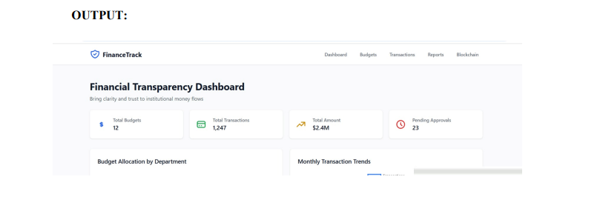
Graph Analysis
Dashboard
Gives overall snapshot → 12 budgets, 1,247 transactions, $2.4M total, 23 pending approvals.
Ensures financial clarity by combining budgets, transactions, and pending actions in one view.

Slide 9

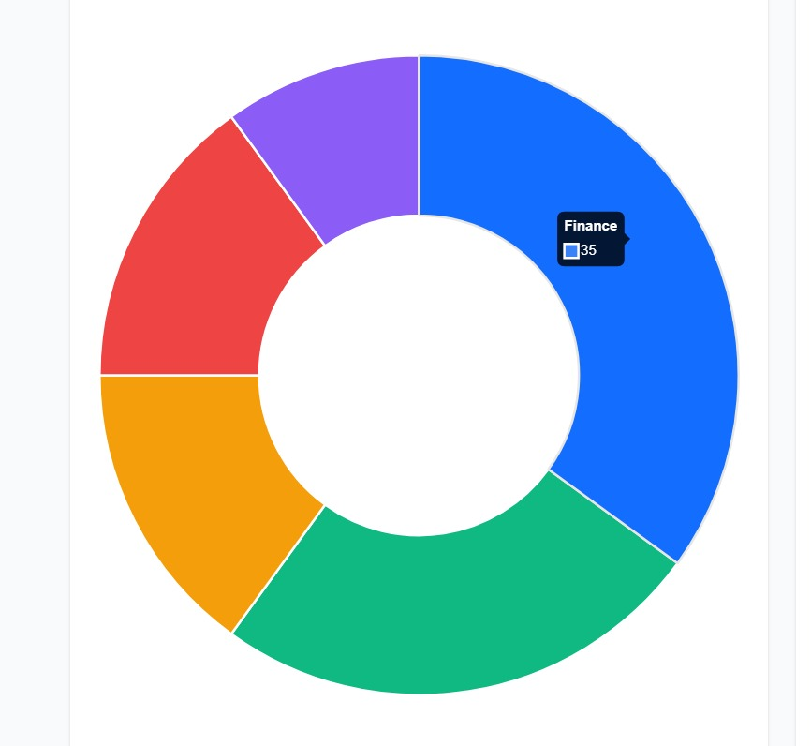


Graph Analysis
Pie chart Transactions
Recent key transactions → Office Supplies ($2,450, Completed), Software License ($15,000, Pending), Equipment Maintenance ($8,750, Approved).
Transaction count → 1,247 verified through blockchain, totaling $2.4M.

Slide 10

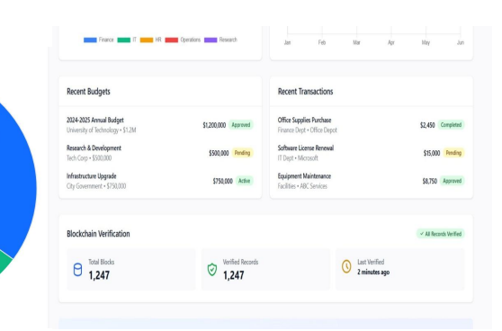
Graph Analysis
Recent Budget and Recent Transactions
Recent key transactions → Office Supplies ($2,450, Completed), Software License ($15,000, Pending), Equipment Maintenance ($8,750, Approved).
Transaction count → 1,247 verified through blockchain, totaling $2.4M.

Slide 11
Git Hub Linkt Hub Link
https://github.com/snehashreemurthy9980-crypto

Slide 12
Limitations
The system will be implemented in a phased manner (starting with specific departments or institutions first) to ensure accuracy, usability, and steady adoption.
The effectiveness of the system depends on the availability and timely update of authentic financial data, which also ensures that the platform stays transparent and traceable.
To make the solution easy to understand for all stakeholders, the initial version will provide simplified dashboards, while advanced analytics will be introduced gradually.
The platform will first cater to key stakeholder groups (citizens, students, parents) before expanding to broader audiences, ensuring user-friendly experiences.
The system may prioritize security and data integrity over extremely fast processing in the early stages, reinforcing trust among users.

Slide 13

Future Scope
AI Insights – Use predictive analytics to forecast fund requirements and detect unusual spending. This helps in smarter planning and misuse prevention.
Blockchain Security – Introduce blockchain to create tamper-proof transaction records. This ensures complete trust and transparency in fund flow.
Scalability – Expand the system to schools, universities, NGOs, and government bodies. A wider reach will create a unified transparent ecosystem.
Citizen Engagement – Allow citizens to give feedback and raise concerns. This improves accountability and builds stronger public participation.
Impact Tracking – Monitor not just fund transfers but also real-world results, like better infrastructure and service quality. This shows the true value of spending.
Contact Us
123-456-7890
@greatadsmedia
hello@greatadsmedia.com
greatadsmedia.com

Slide 14

Conclusion
Transparent & Trustworthy – Our solution ensures that every step of the fund flow is visible and traceable. This builds confidence among all stakeholders and reduces chances of misuse.
Empowering Stakeholders – Students, parents, citizens, and officials can all access real-time insights. This makes financial data easy to understand and more inclusive.
Accountability & Authenticity – With secure data storage and audit trails, institutions can be held accountable. This guarantees that records remain reliable and tamper-proof.
Towards a Better System – The platform promotes efficiency and reduces corruption risks. It is a step toward building cleaner and more responsible governance.
Future-Ready Impact – Beyond solving today’s problems, the system lays the foundation for smarter fund management. It creates a sustainable model that can scale and adapt for the future.

Slide 15

Thank You

